Slide 1





Noida Institute of Engineering and Technology, Greater Noida
Quality Concepts
Unit: 01
TOTAL QUALITY MANAGEMENT
DHEERAJ TRIPATHI
Assistant Professor
Department of Electronics and Communication Engineering
SUBJECT CODE: AOE0861
B Tech VIII Sem

Slide 2
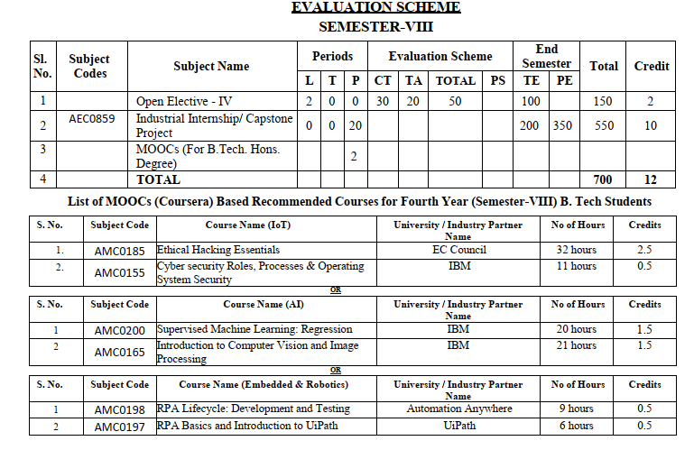
NOIDA INSTITUTE OF ENGINEERING AND TECHNOLOGY, GREATER NOIDA
Evaluation Scheme

Slide 3
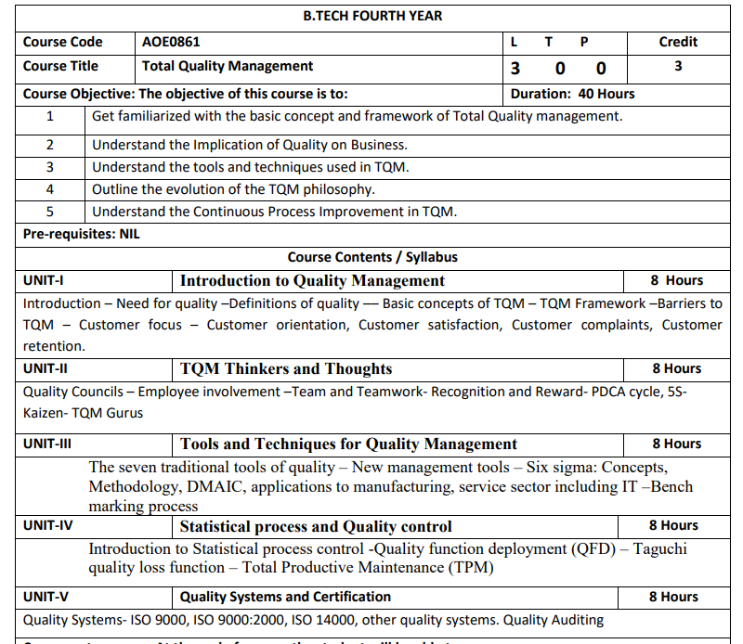
Subject Syllabus
MD.Raza DL&CD Unit1

Slide 4
Branch wise Applications
For all Braches of engineering the Total Quality Management is used to
fault detection on production level
Quality functions in services
Total productive maintenance
Leadership in quality control

Slide 5
Course Objective
The intended objectives of this course are given as follows:
Study about evolution of Total Quality Management, inspection and control of a product.
Study about organization structure , design and quality function
Analysis of control chart and its application
Study of defects diagnosis and its prevention
Study about various standards and its concepts

Slide 6

Course Outcomes
Course outcomes : After completion of this course students will be able to
CO 1 | Study about evolution of Total Quality Management, inspection and control of a product.. . | K1, K2
CO 2 | Study about organization structure , design and quality function | K1, K4
CO 3 | Analysis of control chart and its application | K3
CO 4 | Study of defects diagnosis and its prevention | K2
CO 5 | Study about various ISO standards and its concepts | K2

Slide 7
Program Outcomes
Program Outcomes are narrow statements that describe what the students are expected to know and would be able to do upon the graduation.
These relate to the skills, knowledge, and behavior that students acquire through the programmed.
Engineering knowledge
Problem analysis
Design/development of solutions
Conduct investigations of complex problems
Modern tool usage
The engineer and society
Environment and sustainability
Ethics
Individual and team work
Communication
Project management and finance
Life-long learning

Slide 8
CO-PO Mapping
COs | PO1 | PO2 | PO3 | PO4 | PO5 | PO6 | PO7 | PO8 | PO9 | PO10 | PO11 | PO12
AOE0861.1 | 3 | 2 | 1 | 2 |  |  |  |  | - | - | - | 2
AOE0861.2 | 3 | 3 | 2 | - | - | - | - | - | - | - | - | 2
AOE0861.3 | 2 | 3 | 2 | 2 | - | - | - | - | - | - | - | 2
AOE0861.4 | 3 | 3 | 3 | 2 | - | - | - | - | - | - | - | 2
AOE0861.5 | 3 | 2 | 1 | - | - | - | - | - | - | - | - | 2
AVERAGE | 2.8 | 2.6 | 2 | 2 | - | - | - | - | - | - | - | 2

Slide 9

Program Specific Outcomes
Program Specific Outcomes (PSOs) are what the students should be able to do at the time of graduation. The PSOs are program specific. PSOs are written by the department offering the program.
On successful completion of B. Tech. (EC) Program, the Electronics and Communication engineering graduates will be able to:
PSO1: To apply the knowledge of mathematics, science and electronics & communication engineering to work effectively in the industry based on same or related area.
PSO2: To use their skills to work in modern electronics & communication engineering tools, software and equipments to design solutions for complex problems in the related field that meet the specified needs of the society.
PSO3: To function effectively as an individual and as a member or leader of a team by qualifying through examinations like GATE (Graduate Aptitude Test in Engineering), IES (Indian Engineering Services), PSUs (Public Sector Undertakings), TOEFL (Test of English as a Foreign Language), GMAT (Graduate Management Admission Test) and GRE (Graduate Record Examinations in US) etc.

Slide 10
CO-PSO Mapping
COs | PSO 1 | PSO 2 | PSO 3
AOE0861.1 | 3 | 3 | 3
AOE0861.2 | 3 | 3 | 3
AOE0861.3 | 3 | 3 | 3
AOE0861.4 | 3 | 3 | 3
AOE0861.5 | 3 | 3 | 3
Avg. | 3 | 3 | 3

Slide 11
Program Educational Objectives (PEOs)
Not applicable

Slide 12
End Semester Question Paper Template
B.Tech (Semester -Theory Examination 2021-22) Total Marks : 100
Note: Attempt all sections. If require any missing data, then choose suitably. Time: 3 hours
Section A
1. Attempt all questions in brief. 2 X 10 = 20
Q. No. | Question | Marks | CO
a. to j |  | 2
Section B
2. Attempt any three of the following 3 X 10 = 30
Q. No. | Question | Marks | CO
a to e |  | 10
Section C
Question no. 3,4,5,6,7. Attempt any one of the following 1 X 10 = 10
a |  | 10
b |  | 10

Slide 13
Prerequisite
Prerequisite:
Basic knowledge of Statistical Analysis.
Knowledge of Production process.
Basic Knowledge of Management policy

Slide 14
Brief Introduction about the Subject with videos
This course is intended to provide the students with a comprehensive all essential quality control techniques needed for designers, engineers, manufacturing plants and service sectors. It gives details of quality concepts, control on purchased product, manufacturing quality, Total Quality Management, human factor in quality, control charts, defects diagnosis and prevention, quality standards
Video Link
https://www.youtube.com/watch?v=Iecj9xmIfXM&ab/channel=nptelhrd
https://nptel.ac.in/courses/117/106/11710686
https://www.youtube.com/watch?v=yWlAOFs04gk
https://www.youtube.com/watch?v=QifqIoUNTJl
https://www.youtube.com/watch?v=qb3mvJ1gb9g
https://www.youtube.com/watch?v=2ePeXePNLr

Slide 15

Unit Content
Statistical process and Quality control
Introduction to Statistical process control
Quality function deployment (QFD)
Taguchi quality loss function
Total Productive Maintenance (TPM)

Slide 16
Unit Objective
The intended objectives of this unit are the Study of Statistical process and Quality control

Slide 17
Topic Objective/Topic Outcome
Topic Objective | Topic outcome | Mapping with CO
Introduction to Statistical process control | Student are able to understand basic of statistical process control | CO4

Slide 18
The most important word in Statistical Quality control is Quality The quality of a product is satisfactory when it is able to satisfy the stated and implied needs of the customer.
INTRODUCTION (CO4)
Customer or consumer is a person or organization that use the product.
Quality doesn’t mean merely the goodness or fitness of a finished product. It is a relative term and is used generally with reference to the end use of the product.
Since a product is manufactured for the use of a customer, the requirements of the customer dictates the quality of the product.
Quality is to be planned, achieved, controlled and improved continuously.

Slide 19
INTRODUCTION (CO4)
Distinct meanings of quality
- Quality of Design
- Quality of Conformance
Quality of design refers to the differences in the specifications for products which have the same use.
Eg.: Different brands of razor blades may differ in their specifications w.r.to the steel used, sharpness, corrosiveness, price etc., though they serve the same functional purpose.
Quality of design thus refers to the method of construction, processing, material used, style factors, safety factors etc.

Slide 20
Quality control is a name given to the collection of techniques and devices used to manage, monitor and control all the steps in the production of a product of desired quality. It is a powerful statistical technique for effective diagnosis of lack of quality (or lack of conformity to settled standards) in any of the materials, processes, machines or end products.
INTRODUCTION (CO4)

Slide 21
INTRODUCTION (CO4)
Aims or Objectives of SQC
To improve the company's income by manufacturing products more acceptable to the customers, providing long life, greater usefulness, maintainability etc.
To reduce company’s cost through reduction of the losses due to defects(non conformities), ie. to achieve lower scrap, rework, customer returns etc.
To produce optimum quality at minimum cost.
To ensure satisfaction of consumers with products to build goodwill, confidence, reputation of manufacturers.
Judging conformity of the products to the stated standards and taking suitable action where there are non conformities.
Developing quality consciousness in the organization.
Provide a running commentary on the performance of machines and operations in the production process.

Slide 22
INTRODUCTION (CO4)
Quality Characteristics
When quality is considered, it is specified by one or more characteristics and can be studied independently or jointly.
The quality may be
Technological
(Strength, Hardness, Diameter, Life length etc.)
Psychological
(Taste, Beauty, odour etc.)
Ethical
(Honesty, Integrity, Incorruptibility etc.)
Contractual
(Guarantee, Safety, Provisions etc.)

Slide 23
INTRODUCTION (CO4)
The quality characteristics observed in industry may be generally classified into any of the following categories
Directly measurable (Variable)
( Thickness, life length, temperature, tensile strength etc., producing continuous data)
Non-measurable (Attributes)
(Cracks, Breakages, Assembly defects, Air bubbles etc., producing discrete data)
The variations affecting a production process are broadly classified as being due to two causes – Chance causes (common causes/random causes) - Assignable causes(non random causes or special causes)

Slide 24
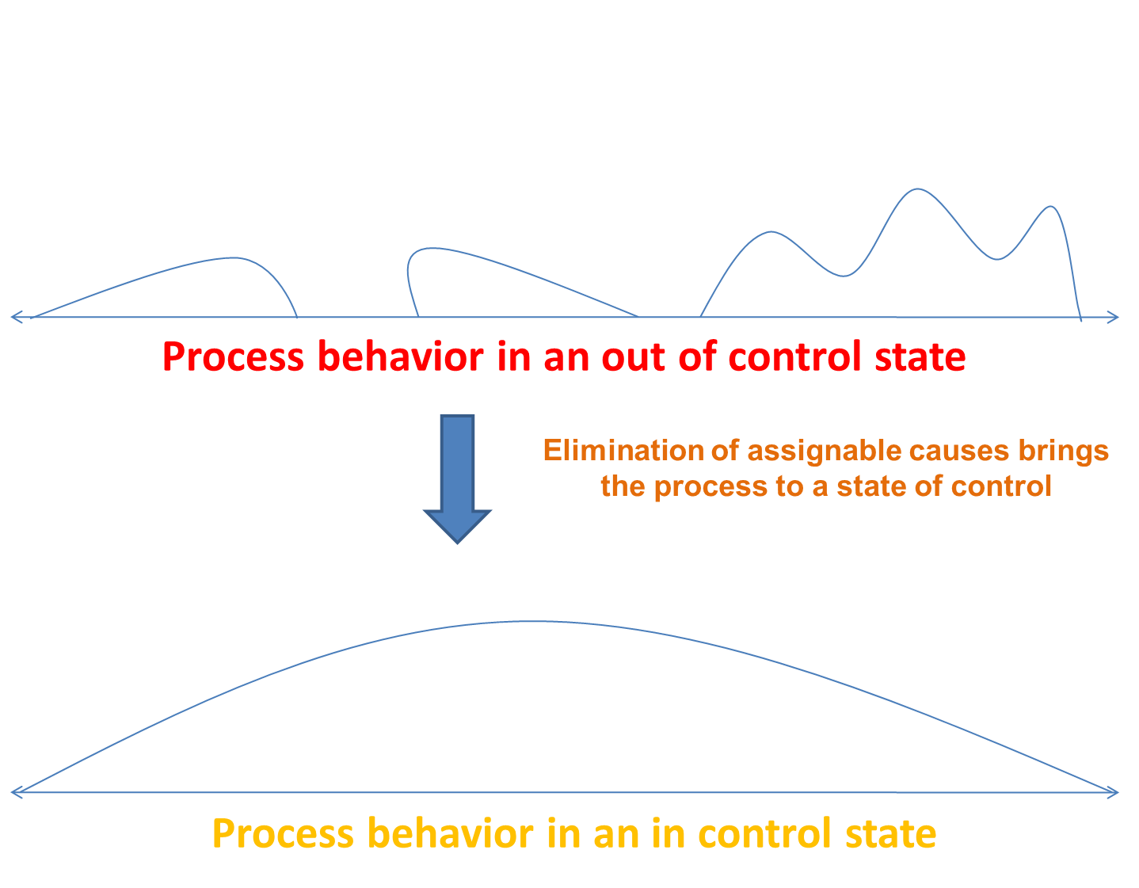
INTRODUCTION (CO4)
The main purpose of Statistical Quality Control is to derive statistical techniques which would help us in separating the assignable causes of variation from the chance causes of variation, thus enabling to take actions whenever assignable causes are present in the production process.
The elimination of assignable causes is described as bringing a process under control.
A production process is said to be under statistical control
( or simply under control), if it is governed by chance causes only, in the absence of assignable causes of variation.

Slide 25
INTRODUCTION (CO4)
Basic principles of SQC
In a production process, we are trying constantly to make products that meet the customers requirements.
We are also trying to make each items or products as much like as the others as possible.
For this we must keep control of our operations.
Just like a doctor use temperature, pulse rate, blood pressure readings, sugar levels, cholesterol levels etc. to keep track of the patients condition, we use control charts to monitor the condition of our production process .
When properly used, control charts will tell us three things,
- When we are doing some thing we should not
- When we are not doing something we should
- When we are doing things right
Generally, control charts will indicate how well our job is. They will provide us with STOP and GO signals.

Slide 26
INTRODUCTION (CO4)
The ideas and techniques of statistical process control are based on the following six principles.
No two things are exactly alike( ie. Variability is inherent in all production processes.
Variation in a product or process can be measured.
Things vary according to a definite pattern
Whenever things of the same kind are measured, a large group of the measurements cluster around the middle ( normal curve assumption)
It is possible to determine the shape of the distribution curve for products manufactured by any process.
Variation due to assignable causes tend to distort the normal distribution curve.
Statistical methods give us a way to picturise and control quality through use of Histograms and Control charts

Slide 27
Topic Objective/Topic Outcome
Topic Objective | Topic outcome | Mapping with CO
Introduction to Quality function deployment | Student are able to understand basic of QFD | CO4

Slide 28
INTRODUCTION (CO4)
Quality function deployment was first developed in Japan in the Kobe Shipyards in 1970.
Today more than 10,000 companies in America and West Europe are utilizing the techniques of QFD.
Automotive industry the furthest in implementation of QFD
QFD is an analytical process which provides an approach to deploying the voice of the customer through all aspects of the product development process.
It is a planning tool used to fulfill customer expectations.
A disciplined approach to product design, engineering, and production and provides in-depth evaluation of a product.

Slide 29
INTRODUCTION (CO4)
Using QFD for new product development always involves a cross-functional team with the skills necessary for designing the product, writing engineering specifications, purchasing materials, and planning the tooling and production work.
The efforts of these teams eliminate rework and typically reduce development time by as much as 50%.
QFD helps identify new quality technology and job functions to carry out operations.
This tool provides a historic reference to enhance future technology and prevent design errors.
QFD is basically a set of graphically oriented planning matrices that are used as the basis for decisions affecting any phase of the product development cycle.
QFD results are measured based on the number design and engineering changes, time to market, cost and quality.
QFD enables the design phase to concentrate on customer requirements, spending less time on redesign and modifications.

Slide 30
QFD TEAMS (CO4)
TYPES OF TEAMS
A. New product.
B. Improving an existing product.
Teams consist of members from marketing, design, quality, finance and production.
TEAM MEETINGS
A. The project manager and team members need to commit a significant amount of time, especially in the early stages.
B. Priorities and the scope of the project need to be clearly defined and told to all departments within the organization so time can be budgeted appropriately.
C. Duration of meetings vary depending on where team’s members are coming from and what needs to be accomplished.

Slide 31
THE VOICE OF CUSTOMER (CO4)
QFD begins with marketing to find out what exactly the customer wants from a product.
Sources for Determining Customer Expectations
1. Focus Groups
2. Surveys
3. Complaints
4. Consultants
5. Standards
6. Federal Regulations

Slide 32
THE VOICE OF CUSTOMER (CO4)
The QFD Team Must Continually Ask:
1. What does the customer really want?
2. What are the customer’s expectations?
3. Are the customer’s expectations used to drive the design process?
What can the design team do to achieve customer satisfaction?
Collecting the Data
Solicited
Unsolicited
Quantitative
Qualitative
Structured
Random

Slide 33
THE VOICE OF CUSTOMER (CO4)
Organizing the Data
The Affinity Diagram gathers a large amount of data and organizes the data into groups based on natural interrelationships.
The Affinity Diagram is ideally suited for most QFD applications;other data organizers include:
Interrelationship Diagrams, Tree Diagrams, Cause and Effect Diagram
Reasons to implement :
Thoughts are too widely dispersed or numerous to organize.
New solutions are needed to circumvent the more traditional ways of problem solving.
Support for a solution is essential for successful implementation.

Slide 34
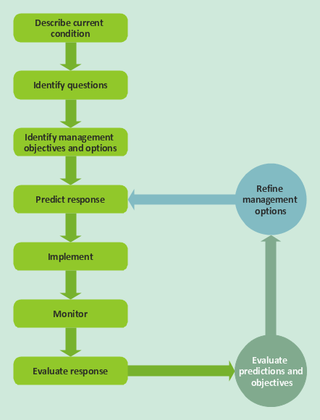
THE VOICE OF CUSTOMER (CO4)
Constructing the Affinity Diagram
Phrase the objective
Record all responses
Group the responses
Organize groups in an affinity diagram

Slide 35
Topic Objective/Topic Outcome
Topic Objective | Topic outcome | Mapping with CO
Introduction to Taguchi quality loss function | Student are able to understand basic of Taguchi quality loss function | CO4

Slide 36
TAGUCHI LOSS FUNCTION (CO4)
Taguchi Methods are statistical methods developed largely by GENICHI TAGUCHI to improve quality of manufactured goods.
The philosophy of off-line quality control.
Innovations in the design of experiments.
Taguchi Loss Function Definition
Taguchi defines Quality as "the loss imparted by the product to society from the time the product is shipped."
LOSS = Cost to operate, Failure to function, maintenance and repair cost, customer dissatisfaction, poor design, injury to health, accidents etc.
Product to be produced "being within specification“

Slide 37
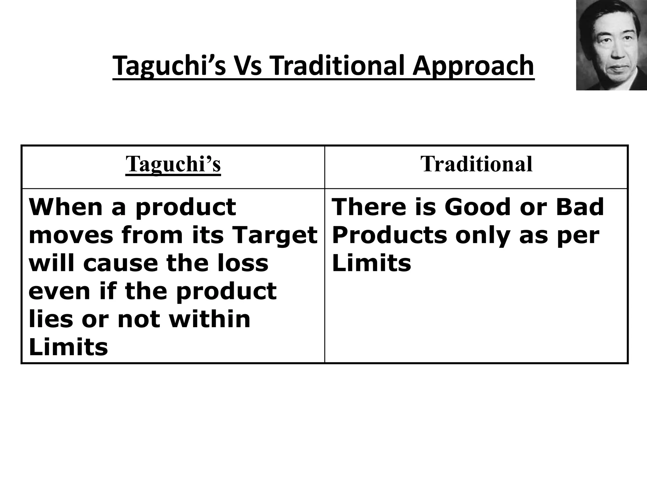
TAGUCHI LOSS FUNCTION (CO4)

Slide 38
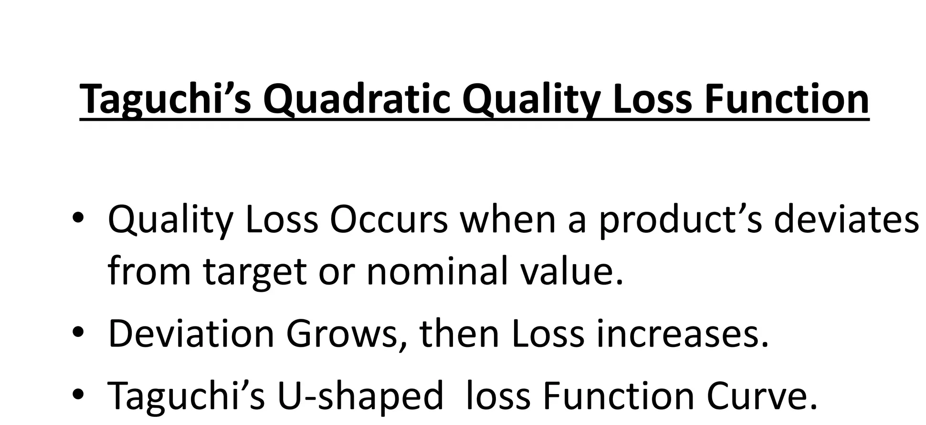
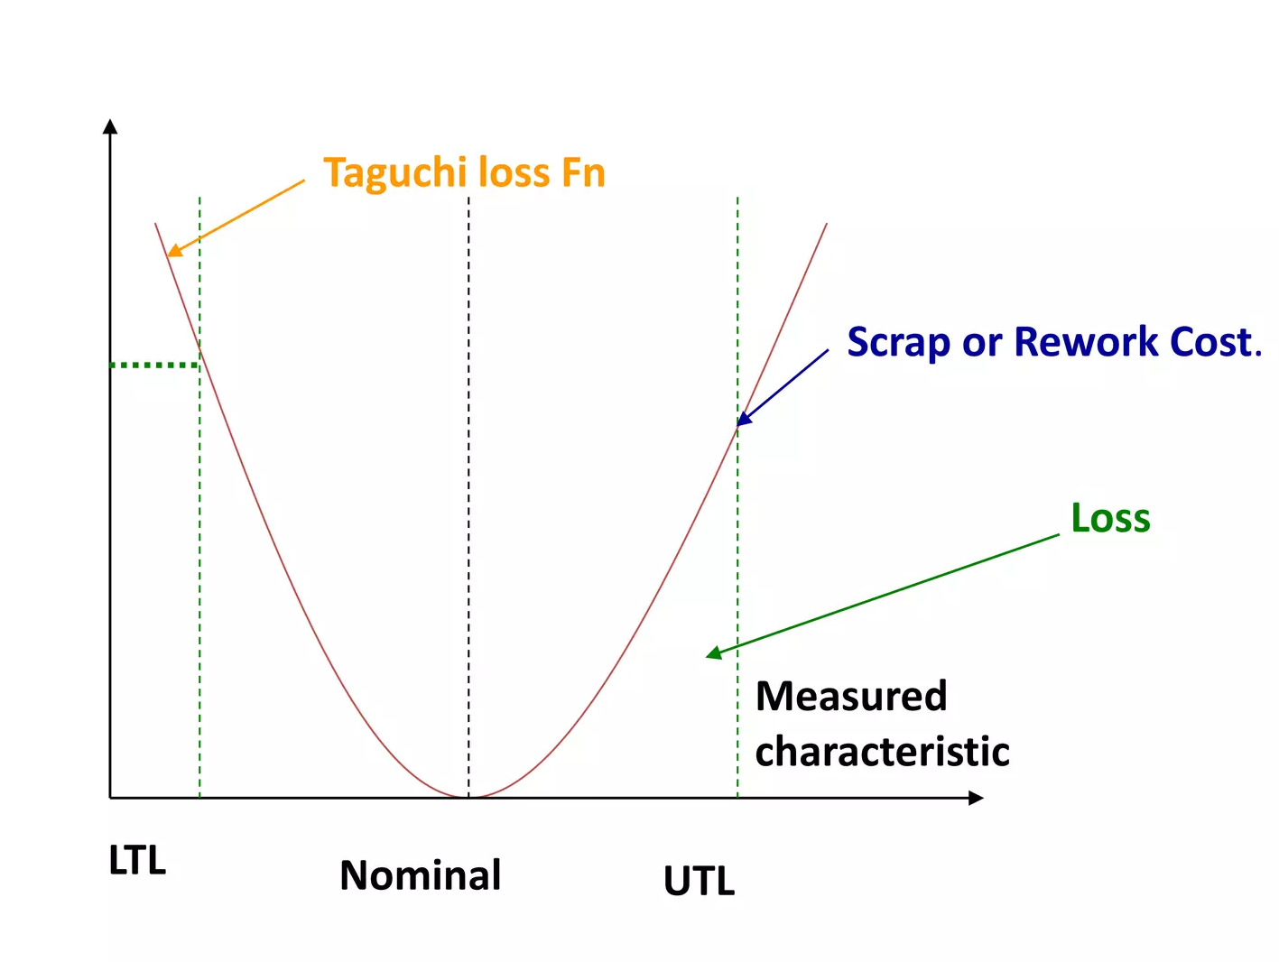
TAGUCHI LOSS FUNCTION (CO4)

Slide 39
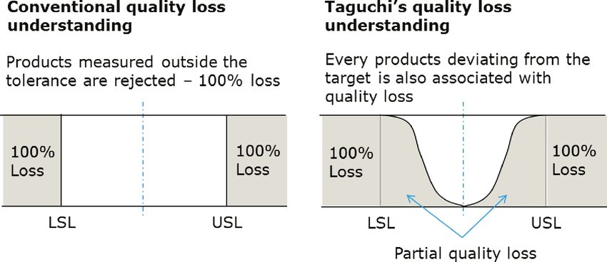
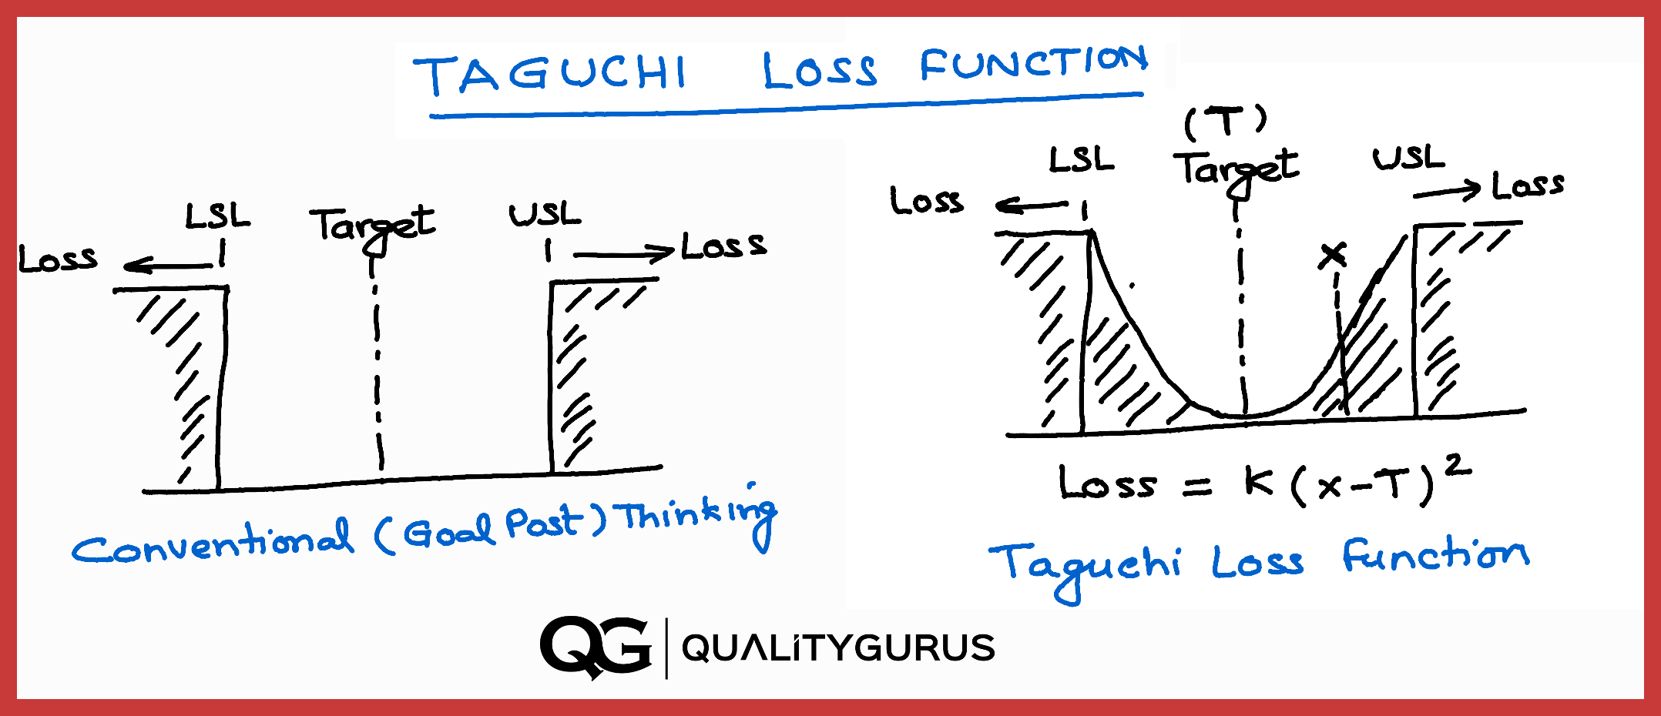
TAGUCHI LOSS FUNCTION (CO4)

Slide 40
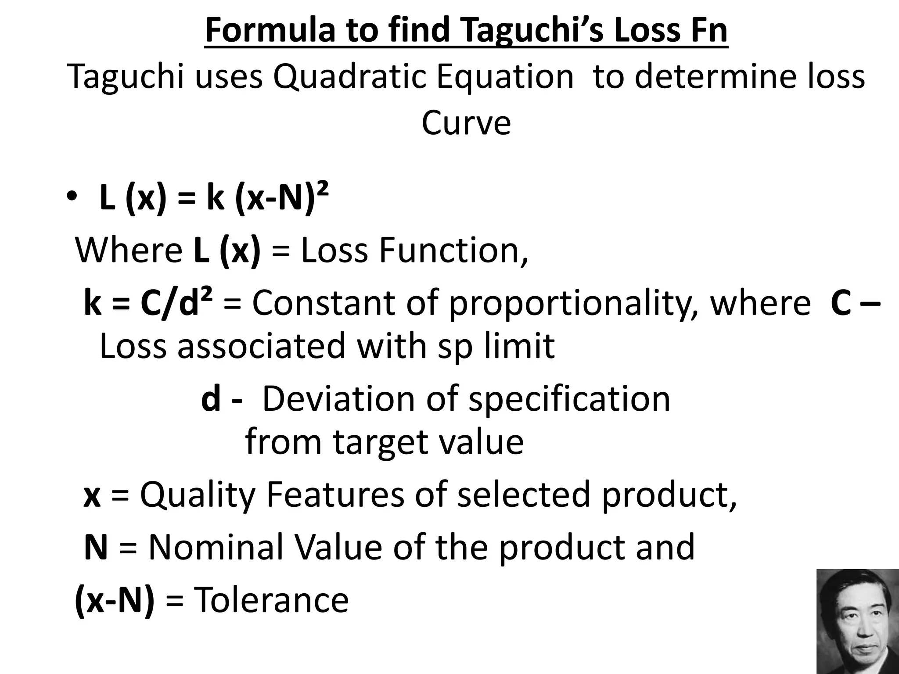
TAGUCHI LOSS FUNCTION (CO4)

Slide 41
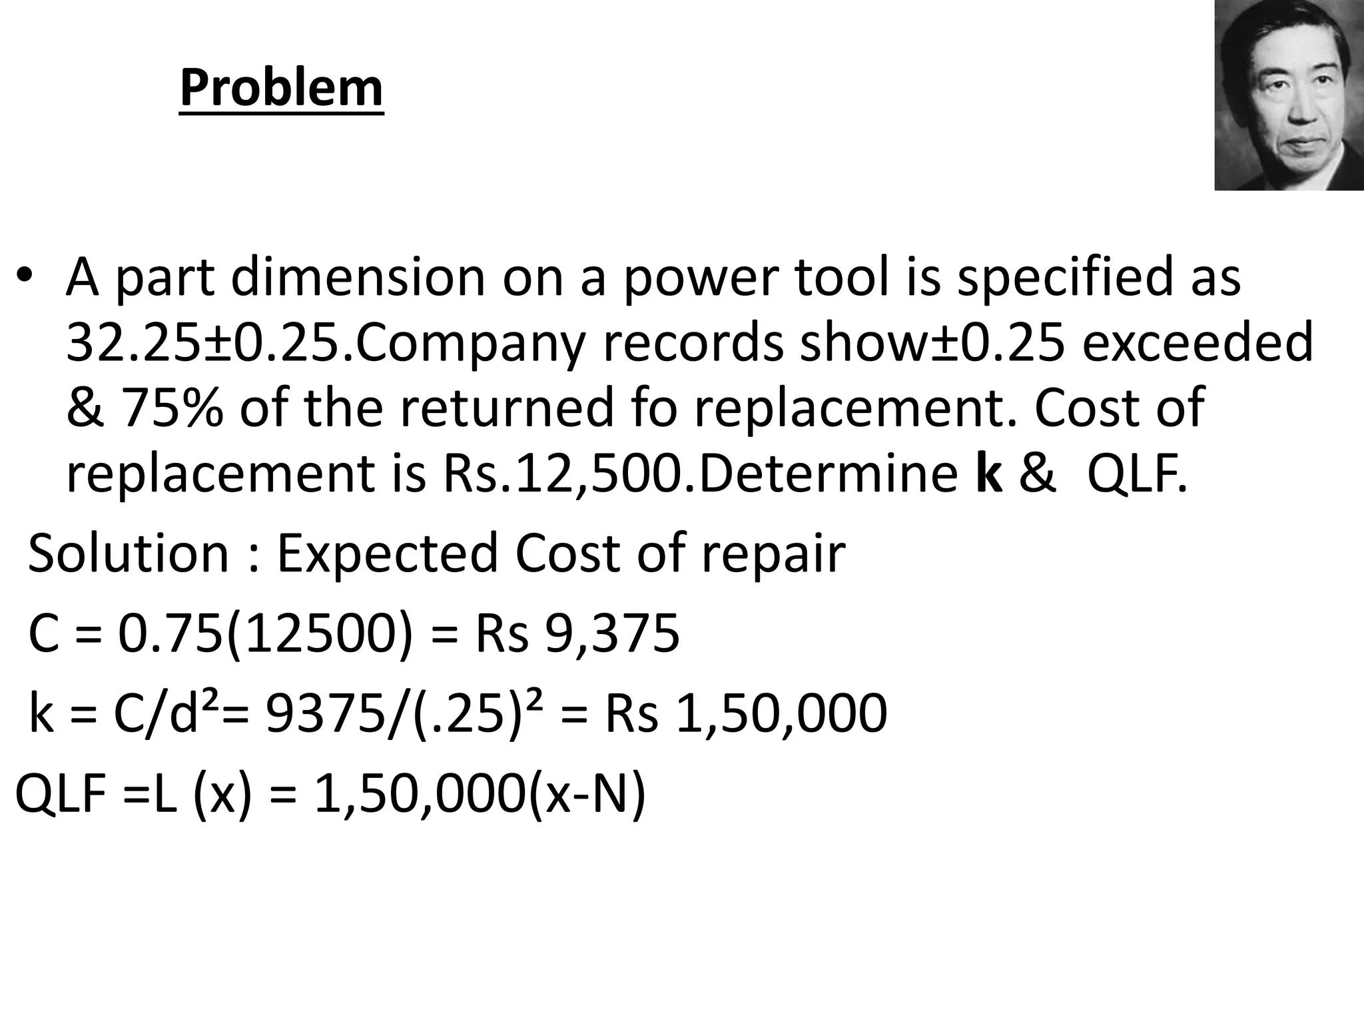
TAGUCHI LOSS FUNCTION (CO4)

Slide 42
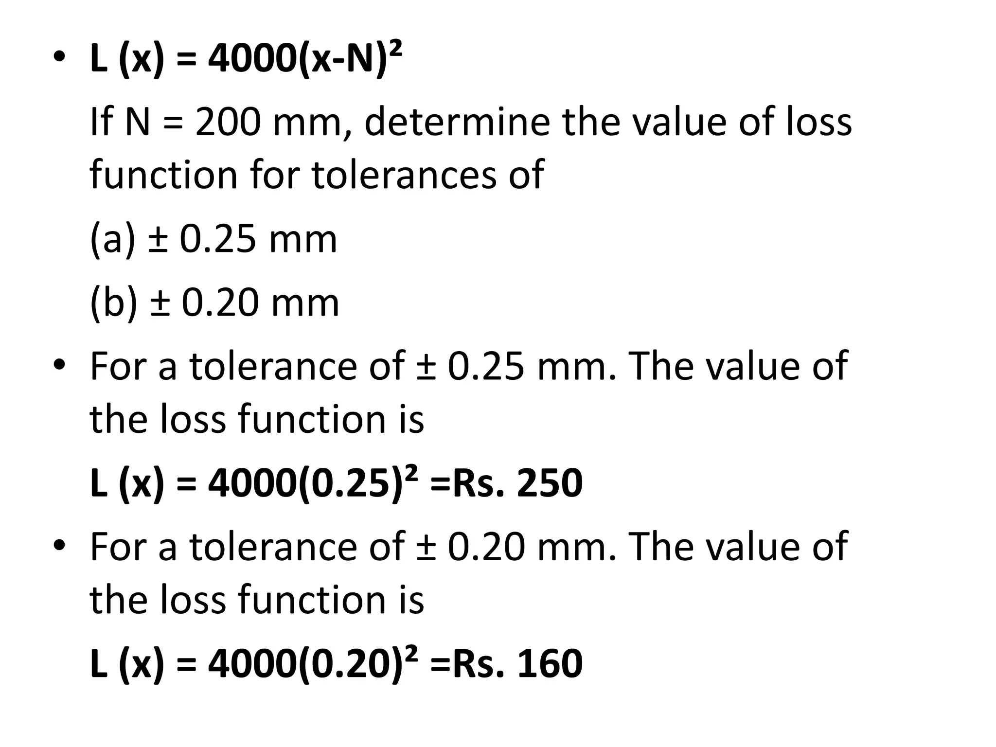
TAGUCHI LOSS FUNCTION (CO4)

Slide 43
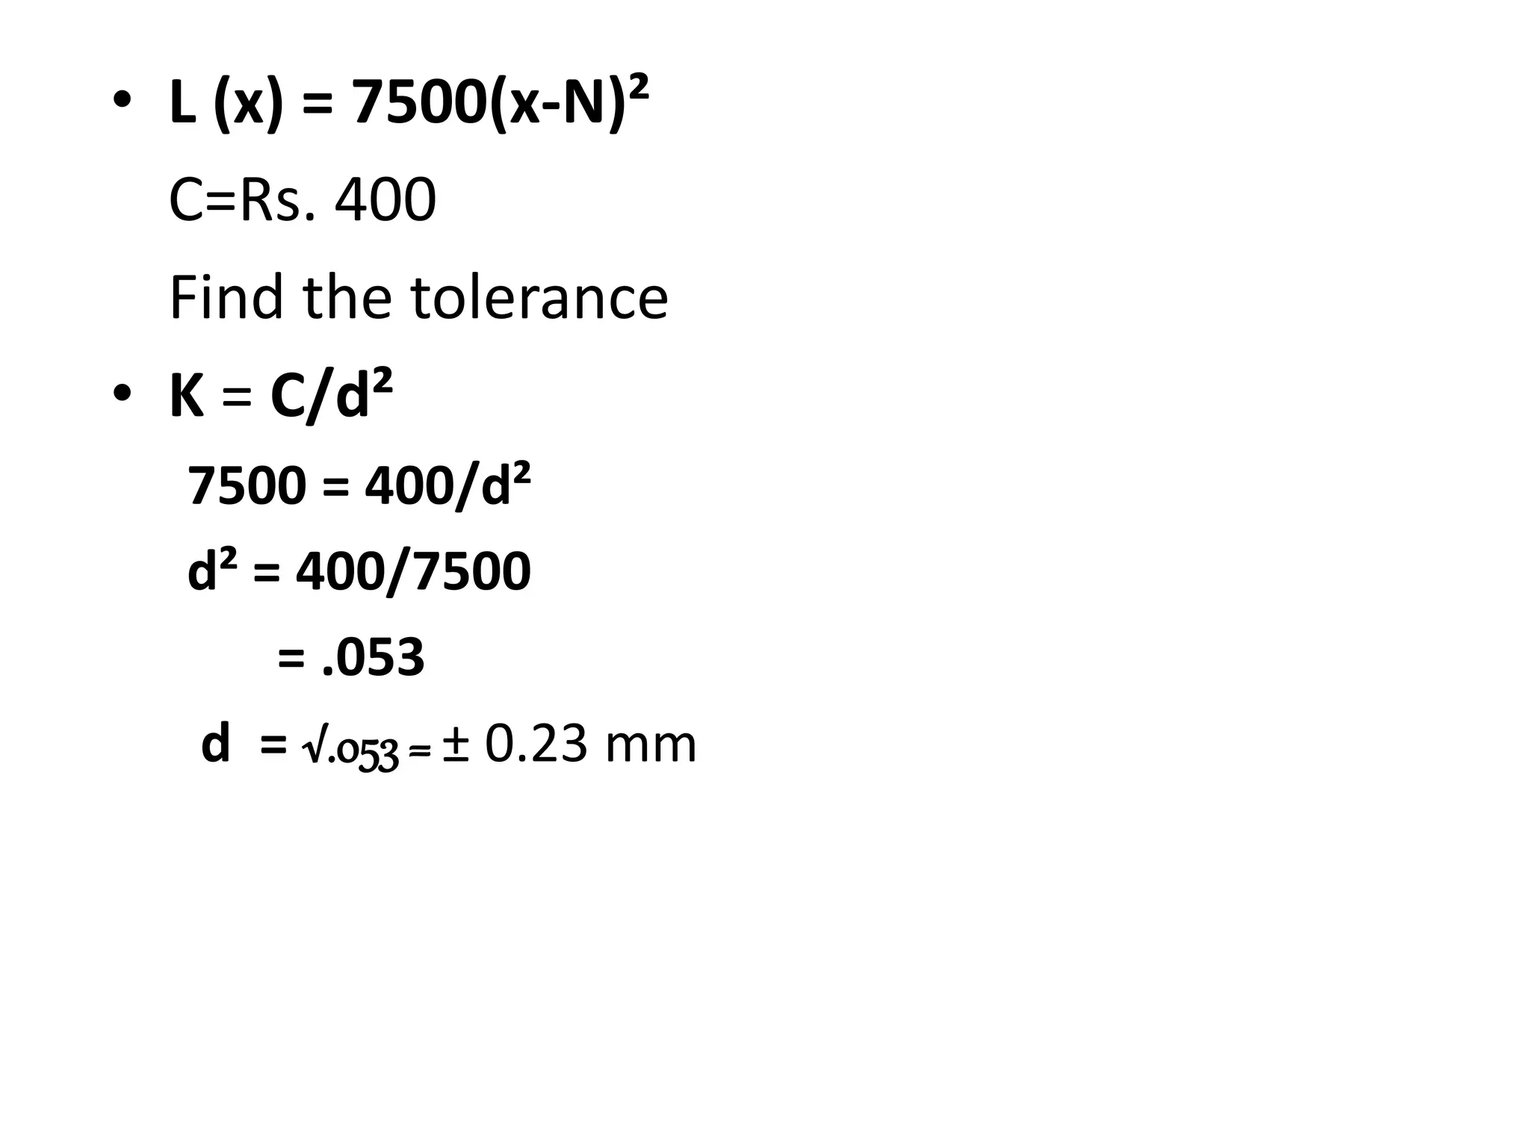
TAGUCHI LOSS FUNCTION (CO4)

Slide 44
Topic Objective/Topic Outcome
Topic Objective | Topic outcome | Mapping with CO
Introduction to Total Productive Maintenance (TPM) | Student are able to understand basic of Total Productive Maintenance (TPM) | CO4

Slide 45
Total Productive Maintenance (CO4)
What is Maintenance?
The Management,control,execution and quality assurance of activitis which ensure the achievement of optimum availability and performance of a plant in order to meet business objectives.
Types of maintenance:
Preventive Maintenance
Predictive Maintenance
Scheduled Maintenance
Breakdown Maintenance

Slide 46
Total Productive Maintenance (CO4)
What is Total Productive Maintenance?
T: TOTAL
Participation of all Employees.
Include all Departments, operation, equipment and process.
P: PRODUCTIVE
Pursue the maximization system of efficiency of the production by making all loses zero.
Zero accidents Zero defects Zero breakdowns.
M: MAINTENANCE
To improve the efficiency of the equipment.
Maintenance means the entire life cycle of the production system

Slide 47
Total Productive Maintenance (CO4)
IT IS A JAPANESE APPROACH, AND IT IS ABOUT TO:
Creating company culture for maximum efficiency
Striving to prevent losses with minimum cost
Zero breakdowns and failures, Zero accident, and Zero defects etc.
The essence of team work (small group activity) focused on condition and performance of facilities to achieve zero loss for improvement
Involvement of all people from top management to operator
TPM first introduced in Japan 20 years ago and rigorously been applied in past 10 years
TPM planning & implementation in Japanese factories supported by JIPM (Japan Institute of Plant Maintenance)

Slide 48
Total Productive Maintenance (CO4)
Why need TPM?
Avoid wastage in a quickly changing economic environment.
Producing goods without reducing product quality.
Reduce cost.
Goods send to the customers must be non defective.
TPM Objectives:
Increase production while, at the same time, increasing employee morale and job satisfaction.
Hold emergency & unscheduled maintenance to a minimum.
To provide the safe and good working environment to the worker.
Achieve Zero Defects, Zero Breakdown and Zero accidents in all functional areas of the organization.
Involve people in all levels of organization.
Form different teams to reduce defects and Self Maintenance.
To fulfill Regulatory compliances.

Slide 49
Total Productive Maintenance (CO4)
TPM TARGETS:
1 PRODUCTION
i) Obtain Minimum 80% Overall Production Efficiency
ii) Obtain Minimum 90% Overall Equipment Effectiveness
iii) Run the Machine during lunchtime
2 QUALITY
Operate in a manner, so that there are no customer complaint
3 COST
Reduce the manufacturing cost as much as possible
4 DELIVERY
Achieve 100% success in delivering the goods as required by the customer
5 SAFETY
Maintain an accident free environment
7 MULTYTASK
Develop multiskilled & flexible workers.

Slide 50
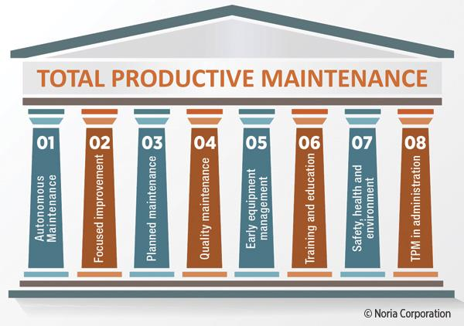
PILLARS OF TPM (CO4)

Slide 51
PILLARS OF TPM (CO4)
PILLAR 1:
Focused improvement
The Focused Improvement pillar is basically synonymous with Kaizen, the Japanese organizational philosophy focused on implementing incremental improvements.
Characteristically of Kaizen, all personnel involved in production are encouraged to pay attention to, look for, and suggest improvements.
The ultimate goal being, naturally, to reduce production-related issues and keep the line flowing.
Practically, Kaizen in TPM entails forming cross-departmental team that brainstorm about how to address issues related to machinery and equipment.
These are called Kaizen events or Kaizen blitzes.

Slide 52
PILLARS OF TPM (CO4)
PILLAR 2:
Autonomous Maintenance
Autonomous maintenance enables operators to fulfil duties that would normally be performed by maintenance personnel.
It stimulates frontline workers to take ownership of their machines and perform routine maintenance practices like cleaning, inspection and lubrication (CIL) tasks.
This pillar connects operators to their machines and allows engineers and maintenance teams to focus on tasks that require a higher level of expertise.
Autonomous maintenance enables operators to detect faults early and tackle minor issues before they develop into large problems.
Over time, implementing autonomous maintenance will have a big impact on shop floor performance.

Slide 53
PILLARS OF TPM (CO4)
PILLAR 3:
Quality Maintenance
This TPM pillar aims to reduce quality defects and, consequently, the need to rework defective products.
The ultimate goal is to increase production efficiency, eliminate rework-related costs, and improve customer satisfaction.
Defects can be managed through RCAs and by implementing preventative measures like digital production start-up checklists.
PILLAR 4:
Planned Maintenance
Breakdowns can be prevented by scheduling maintenance activities when a machine isn’t scheduled for production.
This ensures that maintenance has no impact on the flow of production.
Closely related to autonomous maintenance, this pillar lets operators perform maintenance tasks to free up time for maintenance and engineering teams.

Slide 54
PILLARS OF TPM (CO4)
PILLAR 5:
Early Management
This pillar enables a fault-free and smooth implementation of new equipment and machinery.
By applying the knowledge gained through the application of other pillars (e.g. autonomous maintenance), the installation and start-up time can be lowered, while maintenance is done properly from the start.
PILLAR 6:
Training and Education
Naturally, investing in the continued education of operators and management will enable to manage the increasing complexity of modern machinery.
This sixth pillar encourages managers to survey the capabilities in their factory.
This gives them an overview of the present skill and enables them to make substantiated investments in training and education.

Slide 55
PILLARS OF TPM (CO4)
PILLAR 7:
Safety, Environment, and Health (SHE)
This pillar aims to create a workplace that is free of any hazards and safety risks.
It can be corrective as well as preventive:
Corrective actions fix something after it has happened,
while preventive actions proactively look at possibly unsafe situations and mitigate them before they turn into an accident.
Next to the elimination of accidents from the shop floor, this pillar seeks to create a work environment that is healthy for its workers, both physically and mentally. Attention should be paid to issues like air quality, proper workload, available facilities and so on.

Slide 56

PILLARS OF TPM (CO4)
PILLAR 8:
Administrative TPM
Last but certainly not least, the Administrative TPM pillar includes aspects of an organization outside of the shop floor, like logistics and planning.
It aims to apply the TPM philosophy to other processes within a business to, just like with equipment, eliminate waste and cut costs.

Slide 57
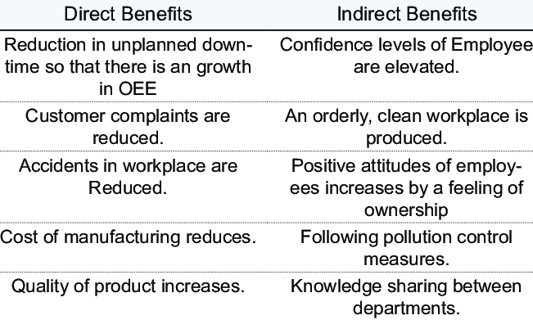
BENEFITS OF TPM (CO4)

Slide 58
DAILY QUIZ
What Is PDCA?
What is Four Phases of the PDCA Cycle?
When to Use PDCA?
How to Use PDCA in Your Life?
What is the key points of PDCA?

Slide 59
WEEKLY ASSIGNMENT
Explain what is QFD, (Quality Function Deployment)?
What is management’s role in continual quality improvement ?
Discuss the Kaizen approach. Explain pdca cycle
Explain zero defect
Explain 5S
Define benchmarking
​How can you apply benchmarking data?

Slide 60
Topic Links
https://www.youtube.com/watch?v=QEOCAuExJU
https://www.youtube.com/watch?v=yWlAOFs04go
https://www.youtube.com/watch?v\=QifqIoUNTJM
https://www.youtube.com/watch?v=qb3mvJ1gb9g
https://www.youtube.com/watch?v=ePeXePNLrs

Slide 61
MCQs
1. What is meant by Kaizen?
a. card signal b. to avoid inadvertent errors c. change for better quality d. none of the above
2. Match the following group 1 items with group 2 items 1. Sort -------------------------------------------------- A. Seitan 2. Set in order ----------------------------------------- B. Seiketsu 3. Shine ------------------------------------------------ C. Seiri 4. Standardize ---------------------------------------- D. Seiso
a. 1 – D, 2 – A, 3 – B, 4 – C b. 1 – C, 2 – A, 3 – D, 4 – B c. 1 – B, 2 – C, 3 – A, 4 – D d. 1 –A, 2 – C, 3 – D, 4 – B

Slide 62
MCQs
3. What is meant by P, D, S and A in PDSA cycle?
a. Progress Development Study Act
b. Plan Do Study Act
c. Project Development Study Act
d. Prevention Do Study Act
4. Plan-Do-Check -Act cycle is related to:
a. Donabedian
b. Deming
c. Henry Gantt
d. None of these

Slide 63
MCQs
4. Match The Following
A. TQM promotes 1. Small change
B. Kaizen is 2. Continuous improvement
C. Quality circle can solve 3. Employee participation
problem related to
D. Quality circle benefit to 4. Employee
5. The correct order is
A-3, B-1, C-2, D-4
A-1, B-3, C-2, D-4
A-3, B-1, C-4, D-2
A-3, B-2, C-1, D-4

Slide 64
MCQs
6. Reliability of product means
Consistency of performance
Performance over period
Free of technical errors
The correct answer is
i & iii
i & ii
ii & iii
i, ii & iii
7. According to Deming, Quality problems are
a. Due to management
b. Due to method
C . Due to machine
d. Due to material

Slide 65
Glossary Questions
Pick the correct answer from given Glossary
(Quality Circle, defect, Failure, failure ,Training )
1. A non-conformance to a requirement is known as _______
2. A _____ is a defect that reaches the customer
3. A group of workers who do the same or similar work is known as _____
4. One of the Cause of failure is a lack of ____

Slide 66
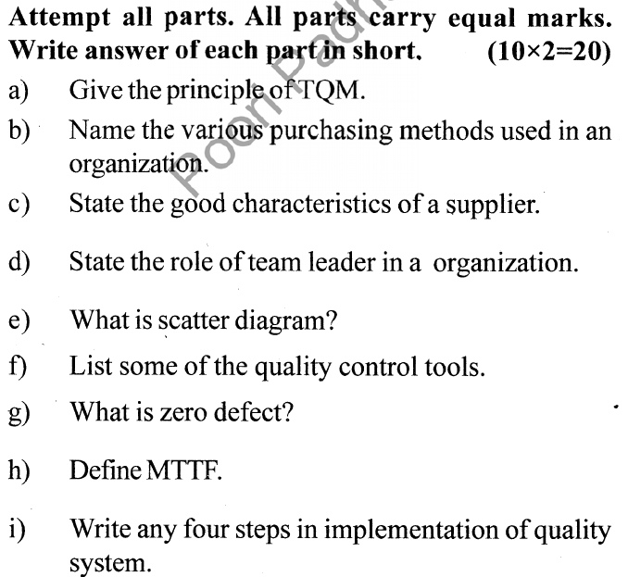
OLD QUESTION PAPERS

Slide 67
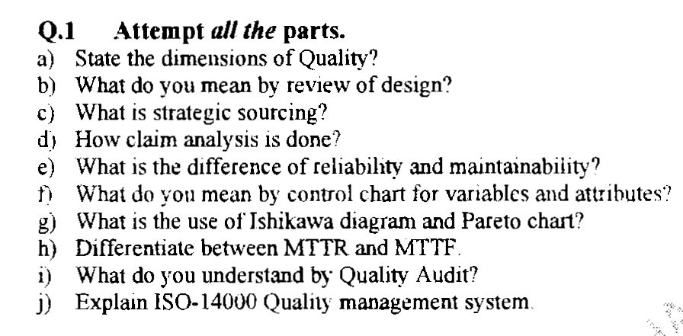
OLD QUESTION PAPERS

Slide 68
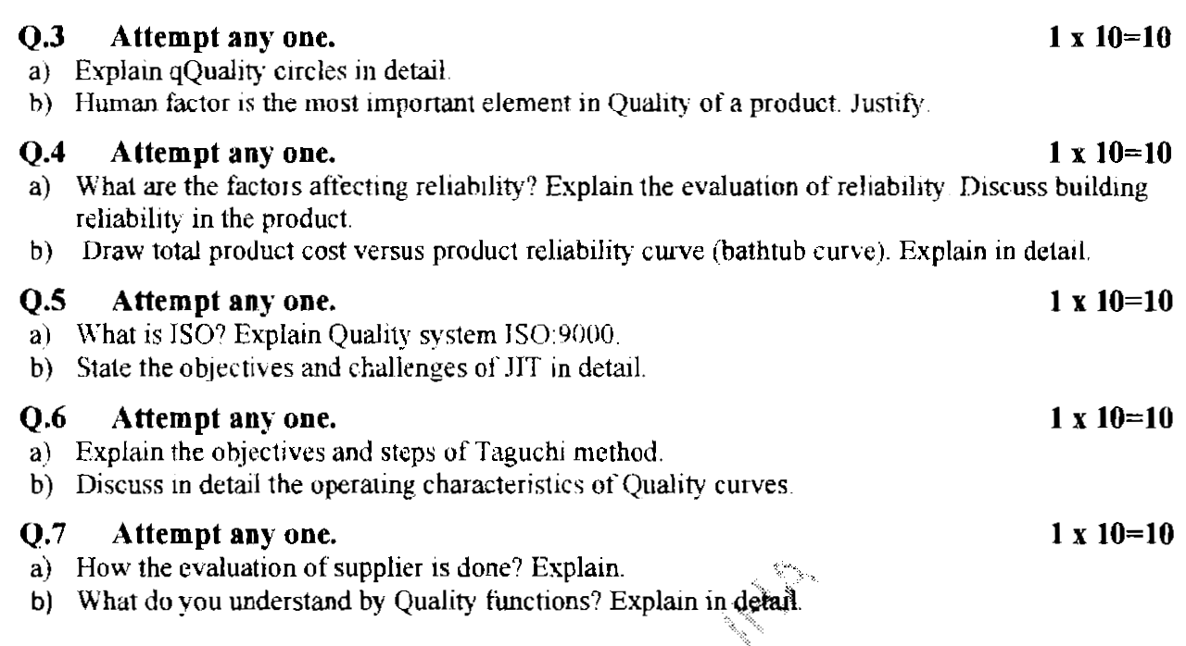
OLD QUESTION PAPERS

Slide 69
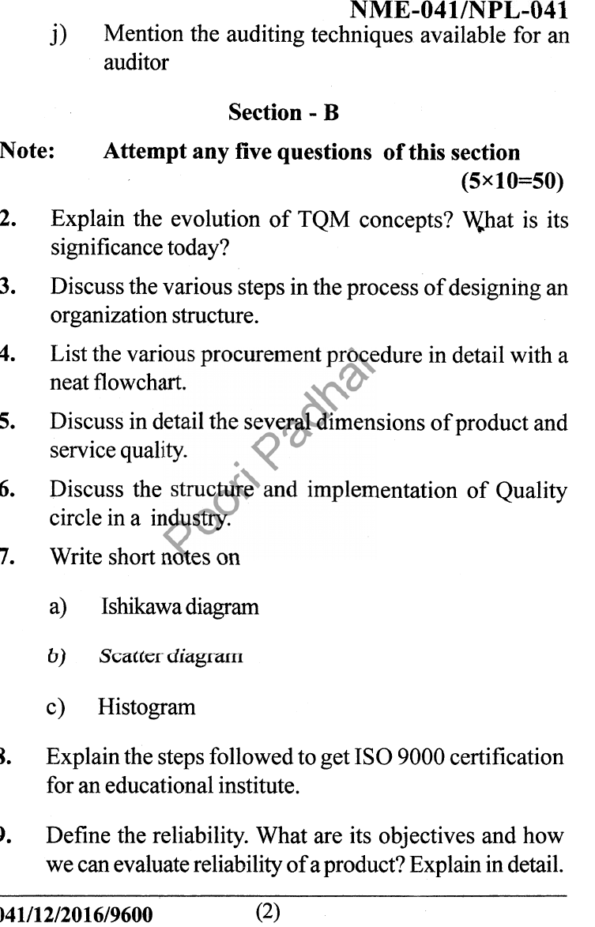
OLD QUESTION PAPERS

Slide 70
EXPECTED QUESTIONS FOR UNIVERSITY EXAM
Explain the reliability and factors affecting it.
Explain the procedure of calculation of reliability.
Explain quality circle in details.
What do you understand by quality function?
Explain PDCE cycle with example.
What is zero defect
What is MTTF
What are the phases of a Continuous Process Improvement Cycle?
Define 5S?
What is a Kaizen?

Slide 71
EXPECTED QUESTIONS FOR UNIVERSITY EXAM
7. What are the types of teams?
8. What are the stages of team development?
9. Give some common team problems?
10. Give the steps involved in training process?
11. What are the three components of the Juran Trilogy?
12. What are the phases of a Continuous Process Improvement Cycle?

Slide 72
Recap of Unit
The MTTF formula is a key part of the overall reliability equation. When failure of an individual component (such as a fan belt) will lead to failure of a motor that will shut down an entire system or production line, being able to predict when that component is likely to fail, and replacing it before the failure occurs, is essential to reduce costly repairs, minimize downtime and maximize equipment lifespan.

Slide 73
Recap of Unit
Knowing and understanding MTTF can help organizations reduce downtime and develop better maintenance strategies, driven by reduced dependence on reactive maintenance and increased predictive or planned maintenance.

Slide 74
REFERENCES
Lt. Gen. H. Lal, “Total Total Quality Management”, Eastern Limited, .
Greg Bounds, “Beyond Total Total Quality Management”, McGraw Hill
Menon, H.G, “TQM in New Product manufacturing”, McGrawHill
https://www.researchgate.net/publication/318654507_Total_Quality_Management_Notes

Slide 75
Thank You

